Slide 1
Prayer
“The rawness of the soul connecting with the goodness of God.”

Slide 2
Some Initial Thoughts
The Stuff of Prayer

Slide 3
Prayer as living out our faith in the real world, not as some ascetic exercise carried out in some mystical nether-world.
Prayer as a natural connection, not an academic pursuit.
Prayer as the rawness of the soul connecting with the goodness of God.
Prayer as discovering what we were built for, instead of questioning if we should have been built at all.

Slide 4
Prayer as the activity which before all other activities, movements, people’s and nations will bend if we just bend our knees.
Prayer not as a lifestyle that we learn, but as the life that we were born to live.
Prayer not as a formula that we concoct, but an intimacy that we develop.
Prayer not as the last resort, but as the first step that will never leave us facing a last resort.

Slide 5
Prayer not as the thing that we squeeze into our day, but the thing that squeezes everything that would kill us out of our day.
Prayer not as a discipline, but as a manifestation of our love for our God.
Prayer as the choice to invade the impossible, not live out our lives hampered by the probable.

Slide 6
Quotes Regarding Prayer
Setting the Stage

Slide 7
“I pray because I can't help myself. I pray because I'm helpless. I pray because the need flows out of me all the time, waking and sleeping. It doesn't change God. It changes me.”
- C.S. Lewis

Slide 8
“We must remember that the shortest distance between our problems and their solutions is the distance between our knees and the floor.”
- Charles Stanley

Slide 9
“I have so much to do that I shall spend the first three hours in prayer.”
- Martin Luther

Slide 10
“The prayer we know as ‘The Lord’s Prayer’ came from the Lord Jesus in direct response to His disciples’ request: ‘Lord, teach us to pray.’ It has always fascinated me that they never asked Jesus to teach them to preach. They never asked Him to teach them to give or to witness. Perhaps, like us, the disciples were often at a loss when it came to communicating with the Almighty.”
- David Jeremiah

Slide 11
“Long as they live should Christians pray, for only while they pray they live.”
- Dwight L. Moody

Slide 12
“Prayer is invading the impossible.”
- Jack Hayford

Slide 13
“Is prayer your steering wheel or your spare tire?"
- Corrie ten Boom

Slide 14
“Praying without ceasing…”
- Apostle Paul

Slide 15
“Father, if you are willing, take this cup from me; yet not my will, but yours be done.”
- Jesus Christ

Slide 16
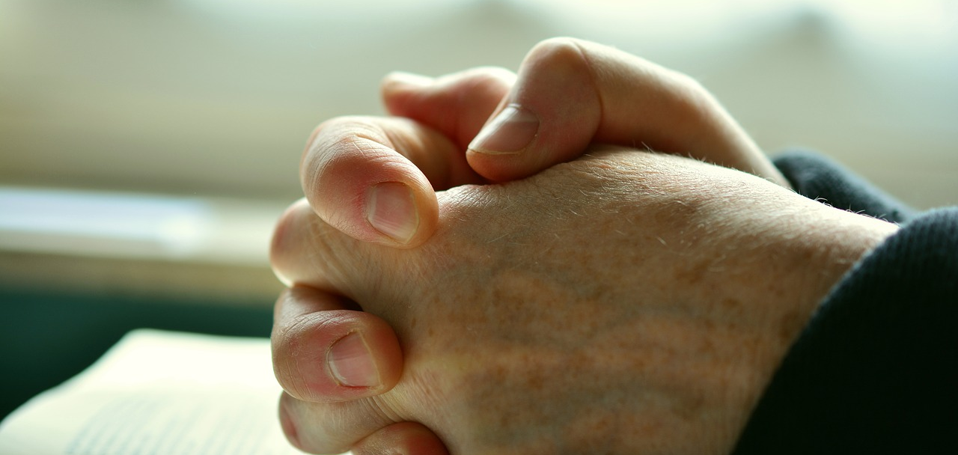
Craig’s Quotes Regarding Prayer
Setting the Stage

Slide 17
“Prayer penetrates the underside of heaven and sends the full force of an invisible realm hurdling against the adversaries that are too naïve to understand what’s about to descend upon them.”
- Craig D. Lounsbrough

Slide 18
“I am convinced beyond words to convey that prayer is infinitely more than the mindless ranting of some poor, delusional soul talking to some imaginary friend in some imaginary place. Oh, to the contrary. Prayer is the manifest pleading of a soul worn raw that, by the simple act of prayer, unleashes untold forces that we can’t imagine that surge in a descent so massive and so inconceivably powerful that the ground of everything before them shakes. And in this descent lives are changed beyond recognition, nations are transformed beyond comprehension, and history is brought to its knees in the face of a God who says, “be healed.” That, my friend, is nothing of a delusional soul or imaginary friend or any other such nonsense.”
- Craig D. Lounsbrough

Slide 19
“How do I tell you what prayer is? It is everything that I need every time I kneel in the practice of it. It shakes the infinite alive and sets its armies afoot in defense of me. It will never run aground or find itself drowning in the waters of the adversity that I bring to it. Nothing it faces is insurmountable, for to think that such an adversary exists is to run a fool’s errand. It will shield me in its advance, it will beckon me to anticipate the miracles that it is about to wield, and in the midst of it all it calms me as it whispers, ‘Be still and know that I am God.’ And because of these reasons and a million more, I find prayer the single greatest place that I could ever imagine being.”
- Craig D. Lounsbrough

Slide 20
“I don’t fight battles by penning words or crafting syntax designed to bring people to tears by liberating their hearts or calling out their souls. Nor do I fight them by sitting with untold thousands and granting them counsel in the darkness of their darkest hours. No. Rather, I fight them prone on my knees in morning’s darkness before the sun has roused a wounded world awake to feel its pain yet again. I fight them throughout the day as I ‘pray without ceasing’ because troubles befall us without ceasing. I fight them by praying for the impossible in lives devastated beyond redemption, for rogue nations that spread destruction as though destroying life was the answer to life, for the weak who stand teetering precariously on some emotional or relational or financial abyss, and for an impossible number of situations that everyone else has deemed as impossible. I fight in prayer. And despite the massive weaponry available to mankind, I am utterly convinced that a single man on his knees in humble petition before God exceeds the armament of all the world’s nations combined. This is what I believe. And
therefore, this is how I fight.”
- Craig D. Lounsbrough

Slide 21
“Prayer is where I trade the rhetoric of men the for the promises of God. It is where I petition perfection instead of count on those who somehow survived an election. It is to accept the incomprehensible invitation of God to have this weak voice of mine thunder down the halls of heaven and roll up to the throne of the God of all eternity so that as small as I am, I might have an audience with this “King of kings.” It is where my fatigue becomes a stage upon which God can unveil His strength in stunning fashion, and where my fear is obliterated by His courage. Prayer is where I rise above this tangled world and find myself enveloped by a world that I visit today, but will live in tomorrow. Prayer is utterly indispensable to this cringing existence, for unless I rise above it I will be consumed by the darkness of it. Prayer is this and does this and will always be this.”
- Craig D. Lounsbrough

Slide 22
Benefits of Prayer Psychological Marriage, Relationships and Friendships Physical Health

Slide 23
Psychological Benefits of Prayer Julia Hogan, LCPC

Slide 24
Psychological Benefits of Prayer Julia Hogan, LCPC
Prayer – Overall Benefits
“According to the University of Maryland Medical Center, individuals who reported having strong religious beliefs were found to report lower levels of anxiety and depression, have lower blood pressure, have a better immune system, and heal faster from surgery.”

Slide 25
Psychological Benefits of Prayer Julia Hogan, LCPC
Prayer Increases Self- Control
“When you pray the Our Father and say, ‘Lead us not into temptation,’ you are identifying just one of the psychological benefits of prayer. It turns out that research has found that prayer can help increase your self-control. Scientific American cited a study where participants were asked to pray for five minutes before being asked to suppress an emotion and concentrate on a task (not an easy task by any means). Those who prayed were better able to suppress their emotions and concentrate on the task at hand than those who did not pray before.”

Slide 26
Psychological Benefits of Prayer Julia Hogan, LCPC
Prayer Regulates Emotions
“Prayer can also help you better regulate your emotions, especially negative emotions. For example, one study found that saying a prayer when angry can help to reduce your feelings of anger. The researchers theorize that prayer can help you reflect on your experiences and change how you think and feel about an event. Often when you’re stressed, you’re more likely to be irritable or quick to react negatively to situations. Taking a God-centered and prayerful approach to the situation will most likely help you react in a more positive and charitable way.”

Slide 27
Psychological Benefits of Prayer Julia Hogan, LCPC
Prayer Reduces Anxiety and Depression
“Researchers have also found that individuals who report having strong religious beliefs experience less of an anxious response and feel calmer, according to the American Psychological Association. Further, research has found that people with strong religious beliefs are less prone to anxiety and depression. While this doesn’t mean that having a strong prayer life will prevent anxiety and depression, it does mean that it can serve as a protective factor.”

Slide 28
Psychological Benefits of Prayer Julia Hogan, LCPC
Prayer Promotes a Calm Mind
“The American Psychological Association cites research that shows that contemplative spiritual practices increase your ability to pay attention and quiet the areas of the brain that focus on the self. This could mean that prayer can help you better focus on calming yourself when anxious. This is a great way to incorporate your faith into research-proven stress-management techniques.”

Slide 29
Psychological Benefits of Prayer
Prayer Reducwa Financial Strain
A study of more than 800 older people found that faith and attendance at religious services offset the emotional toll of financial strain. Researchers at the University of Michigan found that prayer increases gratitude which, in turn, reduces the negative impact of financial difficulties. Source: The International Journal for the Psychology of Religion.

Slide 30
Psychological Benefits of Prayer
Prayer Assists in Recovery From the Loss of a Loved One
Researchers at the University of Michigan found that among 1,723 people age 60 and older, those who believed in a good afterlife were less likely to develop high blood pressure after the death of a loved one. Thus, they were in better health. Source: Journals of Gerontology.

Slide 31
Psychological Benefits of Prayer
Prayer Enhances Overall Satisfaction
Helping others through one’s religious activities increases satisfaction and improves one’s outlook on life, according to a study of more than 2,000 church members located in various parts of the United States. Giving help brought about greater benefits than receiving help. Source: Psychosomatic Medicine.

Slide 32
Psychological Benefits of Prayer
Prayer Improves Mood and Outlook
Numerous studies have found a strong connection between deeply held religious beliefs and less likelihood and incidence of depression. For example, a study of more than 600 middle-age and older adults, by the U.S. Department of Health and Human Services, examined how both men and women experienced the influence of religious beliefs that protected them against symptoms of depression. Researchers found that these were some of the protective experiences: “I feel God’s presence,” and “I feel comfort in my religion or spirituality.” Benefits were comparable for both men and women. Source: Journal of Nervous and Mental Disease.

Slide 33
Psychological Benefits of Prayer
Prayer Calms Anger
Anger not only detracts from human relationships but is also associated with increased health risks, because it puts our stress reaction into overdrive, can raise blood pressure, and if frequent or chronic, can damage the brain. Studies at Ohio State University have found that praying for the well-being of the person with whom one is angry, or even praying for someone else, calms anger and fosters positive emotions and attitudes, such as compassion, that improve overall health. Source: Personality and Social Psychology Bulletin.

Slide 34
Psychological Benefits of Prayer
Prayer Helps Alleviate Panic Disorder
Canadian researchers at the University of Saskatchewan looked at the impact of religion on 56 people suffering from panic disorder, characterized by repeated attacks of intense fear that something bad will occur when not expected. They found that those to whom religion was most important felt less stressed and experienced fewer symptoms of panic attacks. Source: Depression and Anxiety.

Slide 35
Marital/Relational/Friendships Benefits of Prayer Mark Merrill

Slide 36
Marital/Relational/Friendships Benefits of Prayer Mark Merrill
Praying Together Humbles You
“Praying about your concerns and struggles keeps you humble as you share with God and your spouse what things worry you and tempt you, or what you need to figure out. When you pray to God, you are not only talking and listening to Him but also recognizing that He knows all things and controls all things.”

Slide 37
Marital/Relational/Friendships Benefits of Prayer Mark Merrill
Praying Teaches You to be Other-Focused
“Spending time talking and praying together about issues and concerns helps you see life and the troubles of your spouse in a better light. Praying helps you focus on your spouse and others, too.”

Slide 38
Marital/Relational/Friendships Benefits of Prayer Mark Merrill
Praying Together Encourages Vulnerability and Grace
“Prayers of confession or for asking God for help against a temptation allows you to be vulnerable with each other, and to show forgiveness and grace towards each other. It may feel counter-intuitive, but that vulnerability can also strengthen the love and affection you feel for one another.”

Slide 39
Marital/Relational/Friendships Benefits of Prayer Mark Merrill
Praying Together Increases Trust and Intimacy with Your Spouse
“Intimacy is built on trust, and trust is built on how we respond to being vulnerable with each other. Praying together helps you show and receive trust that strengthens the bonds of intimacy in your relationship.”

Slide 40
Marital/Relational/Friendships Benefits of Prayer Mark Merrill
Praying Together Strengthens the Bond of the Marriage/Relationship
“Prayer is also a way to seek God’s wisdom together. As you pray and come to agreements on matters, that discipline then builds unity and strength in the marriage. And prayer is also where you can fight for your marriage when the difficult days come.”

Slide 41
Marital/Relational/Friendships Benefits of Prayer Mark Merrill
Praying Together Helps Your Spouse Know Your Struggles and Needs Better
“Praying together about your struggles and worries also helps you both know how to better pray for each other throughout the week because you get to know each other better. And prayer provides insight on how to help and love each other better, too.”

Slide 42
Marital/Relational/Friendships Benefits of Prayer Mark Merrill
Prayer Changes People
“I really like the quote about prayer from an actor playing C.S. Lewis in the movie Shadowlands: ‘I pray because I can’t help myself. I pray because I’m helpless. I pray because the need flows out of me all the time, waking and sleeping. It doesn’t change God, it changes me.’”

Slide 43
Marital/Relational/Friendships Benefits of Prayer Mark Merrill
Praying Together Reminds You that God is the Sole Source of Life, Truth, Love, and Hope
“When you pray together, you are focusing your minds, hearts, and marriage on God. You are making your marriage God-centered. You are sharing with Him your deepest needs and desires, hopes and dreams…together.”

Slide 44
The Health Benefits of Prayer The Mind Health Report

Slide 45
The Health Benefits of Prayer The Mind Health Report
Living a Longer Life
“Numerous studies have found that people who are religious are likely to live a longer life. For example, an analysis of 42 studies with a total of more than 125,000 people found that in addition to private prayer, attending religious services, and being involved in other church activities predicted a longer and healthier lifespan.”

Slide 46
The Health Benefits of Prayer The Mind Health Report
Coping Better with Breast Cancer
“Praying in an online support group helped breast cancer patients experience less stress, have lower levels of negative emotions, and experience greater well-being, according to a study of 97 patients at the University of Wisconsin-Madison Center of Excellence in Cancer Communications Research. In addition, belief in an afterlife reduced fear of death. Source: PsychoOncology.”

Slide 47
The Health Benefits of Prayer The Mind Health Report
Reducing Genetic Risk for Depression
“Adults with the highest risk of depression, due to a family history of the condition, are one-tenth as likely to suffer from depression if religion is important in their lives and they frequently attend religious services, according to a study at Columbia University. Those who are religious and at lower risk of depression are at least one-fourth as likely to develop depression as their non-religious peers. Numerous other studies show that prayer and other religious practices reduce or alleviate depression, with or without genetic risk. Source: The American Journal of Psychiatry.”

Slide 48
The Health Benefits of Prayer The Mind Health Report
Improving Recovery from Heart Surgery
“People who pray with a positive, hopeful attitude as an ongoing part of their lives prior to undergoing heart surgery, experience less depression and anxiety afterwards, both in the short and long term, according to studies at the University of Washington Health Sciences and the University of Pittsburgh. However, those who pray only after surgery or take a negative view do not experience the same benefits. Another study, at the University of Michigan, tracked 151 patients for a year and found that private prayer significantly improved mood and overall state of being. Source: The Gerontologist.”

Slide 49
The Health Benefits of Prayer The Mind Health Report
Improving Outlook Among Prostate Cancer Patients
“A study of 367 prostate cancer patients at Memorial Sloan-Kettering Cancer Center in New York found that those whose religion gave them a sense of meaning and peace were less likely to experience depression and coped more effectively with their condition. This impact of religious beliefs and practice was not changed by age, marital status, or the stage of disease. Source: Annals of Behavioral Medicine.”

Slide 50
The Health Benefits of Prayer The Mind Health Report
Enhancing Recovery from Brain Injury
“Researchers at Wayne State University, in Detroit, Mich., looked at the impact of religion on 88 people who had suffered traumatic brain injury, examining their function up to 20 years after the injury. Those who felt the strongest connection to a higher power were least distressed, most satisfied with their lives, and experienced better recovery. Source: Rehabilitation Psychology.”

Slide 51
The Health Benefits of Prayer The Mind Health Report
Reducing Impact of Chronic Pain
“Researchers in Belgium studied 202 people with chronic pain and found that those who prayed with a positive attitude were less affected by pain in their daily lives. Although on a physical level, the degree of pain did not appear to change, patients who prayed were better able to manage it and had a more positive outlook on life. Source: Journal of Behavioral Medicine.”

Slide 52
The Health Benefits of Prayer The Mind Health Report
Reducing Risk for Diabetes
“Complications In a group of 556 people with diabetes, researchers at the Medical University of South Carolina found that those who attended religious services, at least occasionally, were less likely to have chronic internal inflammation (measured as C-reactive protein). Inflammation indicates increased risk for heart disease and complications of diabetes. Source: Diabetes Care.”

Slide 53
The Health Benefits of Prayer The Mind Health Report
Lowering Men’s Risk for Fatal Heart Disease
“Researchers at the Harvard School of Public Health tracked the health of more than 28,000 men between the ages of 42 and 77 for 10 years. Those who lacked close friends or a social network and did not attend religious services had significantly increased risk of death from heart disease. Source: American Journal of Epidemiology.”

Slide 54
The Health Benefits of Prayer The Mind Health Report
Lowering Blood Pressure
“A number of studies have shown a correlation between religious beliefs and practice and lower blood pressure. For example, researchers at Duke University tracked nearly 4,000 people age 65 and older and found 40 percent less risk of elevated blood pressure among those who prayed or studied the Bible daily and attended religious services at least once a week. Another study of nearly 15,000 American adults showed that regular attendance at religious services was associated with lower blood pressure. Source: International Journal of Psychiatry in Medicine.”

Slide 55
The Health Benefits of Prayer The Mind Health Report
Shortening Hospital Stays for Heart Surgery
“People with stronger religious beliefs who had heart surgery had fewer complications and, as a result, shorter hospital stays, according to a study of 142 patients by The State University of New Jersey. Prior to their surgery, religious patients were more optimistic and less angry and hostile than those who did not have a strong faith. How often patients prayed or attended church services did not influence complications after surgery. Source: Health Psychology.”

Slide 56
The Health Benefits of Prayer The Mind Health Report
Reducing the Odds of Smoking
“Multiple studies have shown that religious people of all ages are less likely to smoke. One study also looked at the influence of religion on a genetic predisposition to smoke among 315 sets of twins and more than 1,000 pairs of other siblings. Even where there is a genetic risk to take up the habit, researchers at the University of Colorado found that three aspects of religion — personal beliefs, participation in organized religious activities, and being affiliated with a congregation — reduced the influence of genes and lowered the odds of a person starting to smoke. Source: Nicotine & Tobacco Research.”

Slide 57
The Health Benefits of Prayer The Mind Health Report
Reducing Cancer Treatment Side Effects
“In Germany, researchers explored the effect of religious beliefs on side effects of radiation therapy among 105 patients with head and neck cancer. Based on questionnaires about patients’ religious convictions, they classified them as “believers” and “non-believers.” The study found thatas a rule, “believers” felt better before, during, and after the treatment, experiencing fewer adverse effects from the disease and the radiation. Source: Strahlentherapie and Onkologie.”

Slide 58
The Health Benefits of Prayer The Mind Health Report
Slowing Progression of Alzheimer’s Disease
“In a Canadian treatment center, researchers evaluated the effect of religion among 70 people with Alzheimer’s disease. They found that those who placed a high importance on their religious beliefs and private prayer experienced a significantly slower progression of the disease. The researchers were not able to identify how this worked but observed that private religious practice improved mental function to a marked degree. Attending religious services did not seem to slow down progression of the disease. Source: Neurology.”

Slide 59
The Health Benefits of Prayer The Mind Health Report
Improving Immune Function
“People who regularly attend religious services more than once per week have an immune system that functions more effectively, boosting their resistance to viruses and other infections and protecting against damage to cells, according to a study at the University of Iowa. Researchers looked at more than 500 people. They concluded that this was one of the mechanisms that contribute to a longer life among religious people. Source: Health Psychology.”

Slide 60
Prayer – The Frequency and Priority The Average American Day
“Various surveys have been conducted on the matter of how time is used, and the most comprehensive one is the yearly Bureau of Labor Statistics data, on the amount of time Americans spend on various activities:
Sleeping: 8 hours 48 minutes
Personal care activities: 47 minutes
Eating and drinking: 1 hour 11 minutes
Housework: 33 minutes
Food preparation and cleaning up afterwards: 36 minutes

Slide 61
Prayer – The Frequency and Priority The Average American Day
Caring for the lawn and garden: 11 minutes
Managing the household: 8 minutes
Other Household activities: 21 minutes
Buying consumer goods:21 minutes
Time spent on care services: 5 minutes
Other goods and services: 17 minutes
Childcare: 24 minutes

Slide 62
Prayer – The Frequency and Priority The Average American Day
Helping other household members: 7 minutes
Helping and caring for non-household members: 11 minutes
Working: 3 hours and 14 minutes
Work-related activities: 22 minutes
Educational activities: 29 minutes
Socialization and communication: 39 minutes

Slide 63
Prayer – The Frequency and Priority The Average American Day
Watching television: 2 hours 46 minutes
Sports, exercising and recreation: 17 minutes
Other leisure and sport activities: 1 hour and 32 minutes
Telephone calls, emails and regular mail: 9 minutes
Other activities: 32 minutes”

Slide 64
Prayer – The Frequency and Priority The Average American Day
Religious/Spiritual Activities – 9 Minutes
Preaching Today
https://www.preachingtoday.com
Prayer – Average Christian – 1 Minute/Pastors – 5 Minutes
Barna Research Group
https://www.barna.com

Slide 65
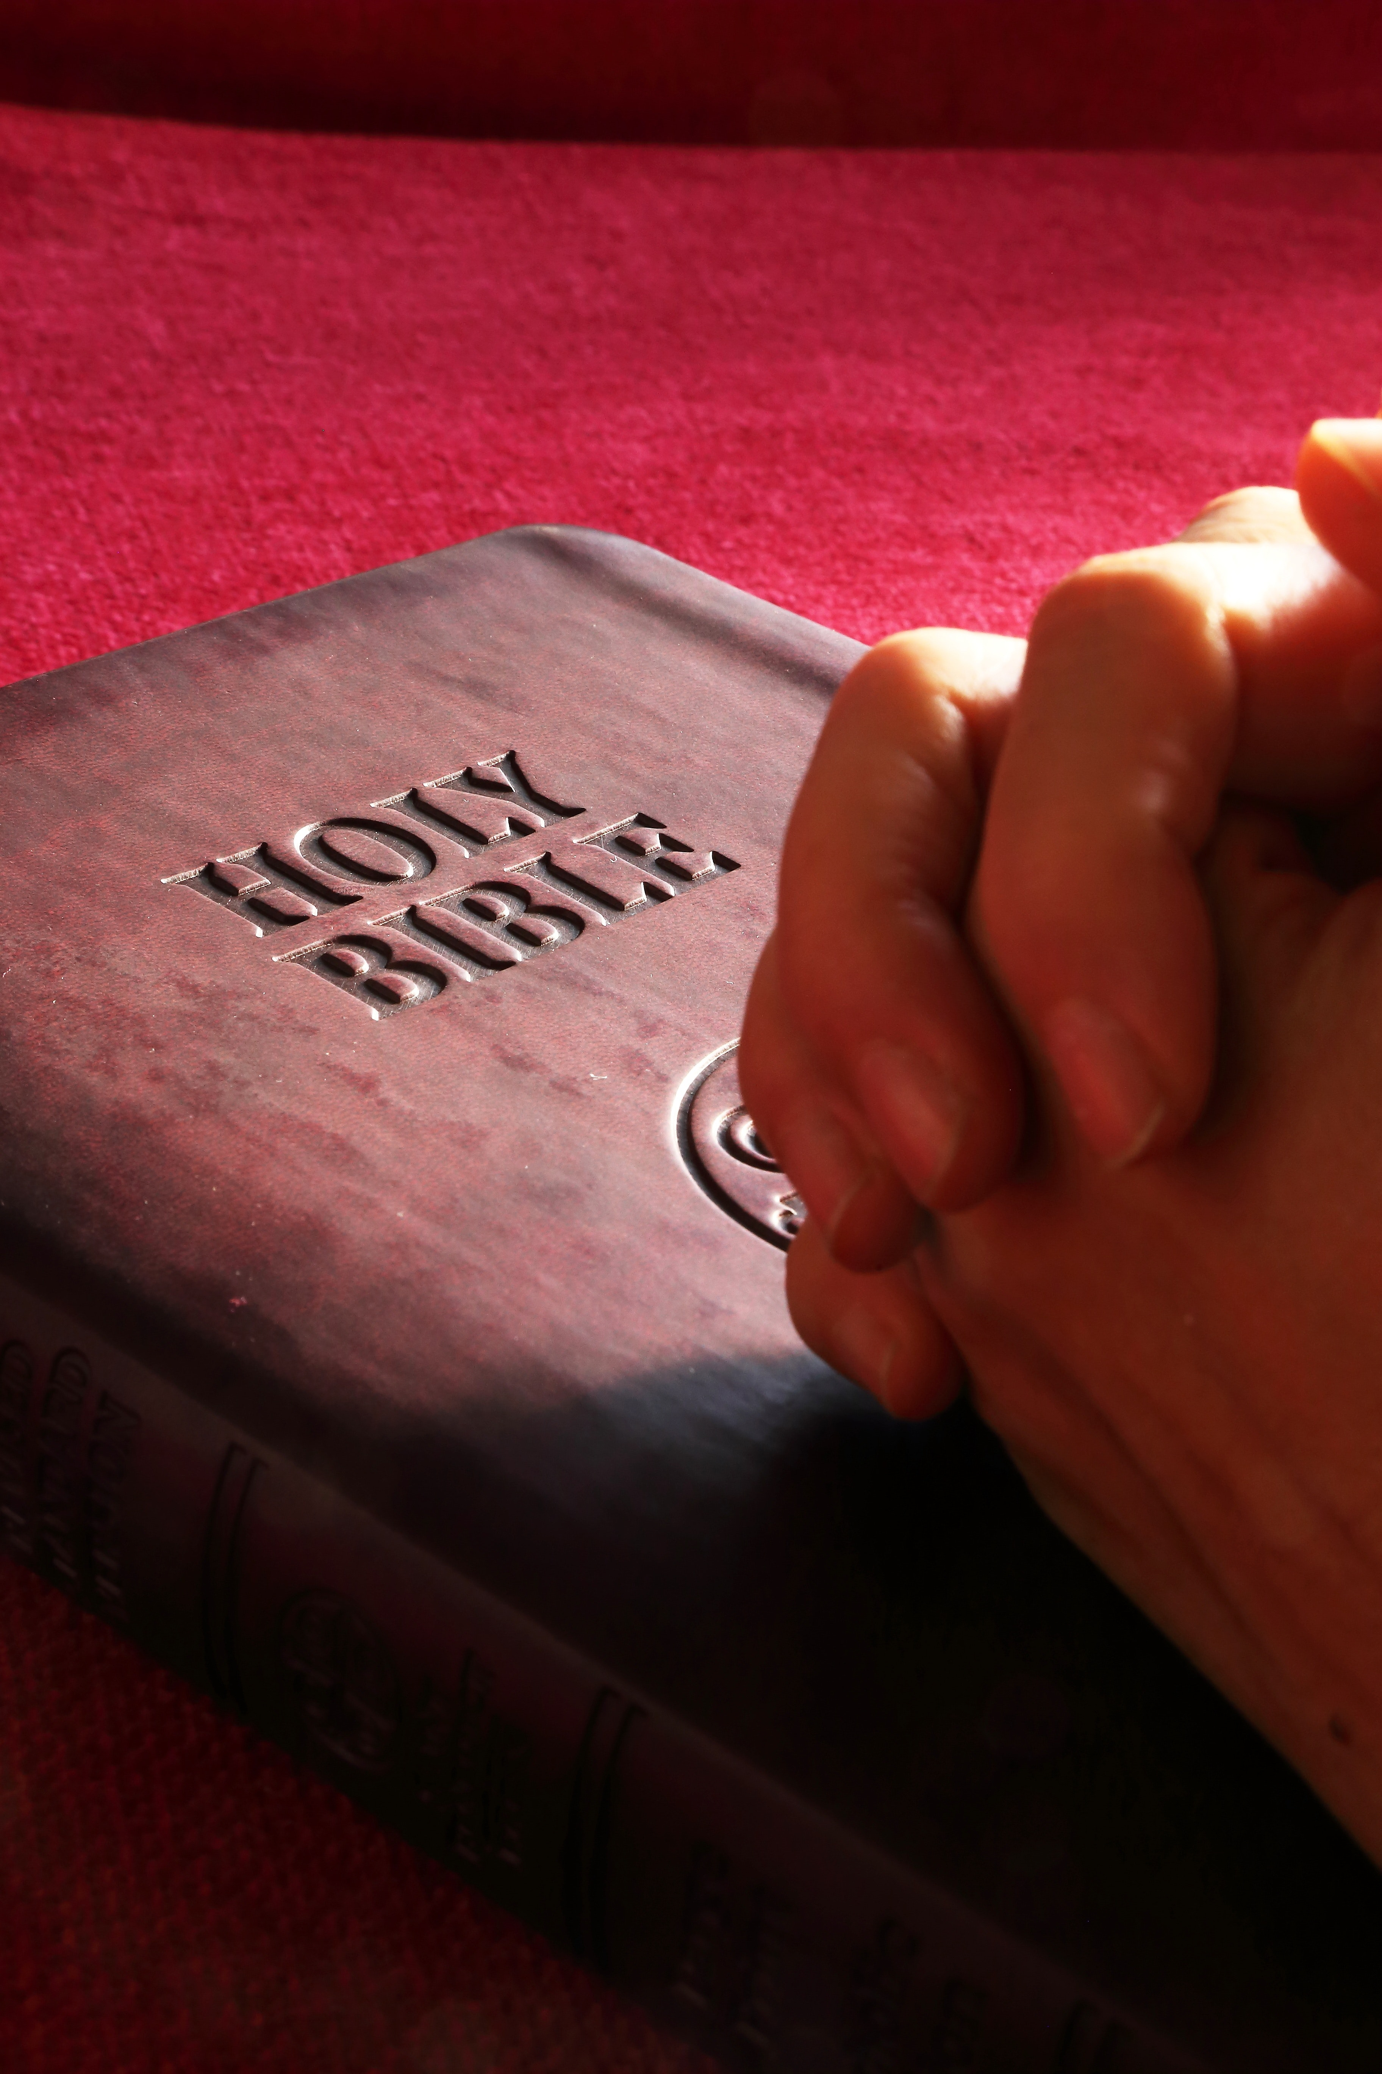
Three Levels of Prayer “The Joshua Code” Reverend O.S. Hawkins

Slide 66
Three Levels of Prayer “The Joshua Code” Reverend O.S. Hawkins
The Level of Presenting a Petition – Matthew 7:7
“Ask, and it will be given to you”

Slide 67
Three Levels of Prayer “The Joshua Code” Reverend O.S. Hawkins
The Level of Presenting a Petition – Matthew 7:7
“Ask, and it will be given to you”
“In the language of the New Testament, the verbs ask, seek, and find are in their present active imperative form. This simply means that the subject is performing the action, the action is ongoing, and it is a command, not an option.”

Slide 68
Three Levels of Prayer “The Joshua Code” Reverend O.S. Hawkins
The Level of Presenting a Petition – Matthew 7:7
“Ask, and it will be given to you”
“On this first level of prayer, intercessors ask and have the promise of God that they will ‘receive.’ When you know God’s will in a matter, you can ask and have the confidence that you will receive.”

Slide 69
Three Levels of Prayer “The Joshua Code” Reverend O.S. Hawkins
The Level of Pressing a Petition – Matthew 7:7
“Seek and you will find”

Slide 70
Three Levels of Prayer “The Joshua Code” Reverend O.S. Hawkins
The Level of Pressing a Petition – Matthew 7:7
“Seek and you will find”
“This is a higher level of prayer than that of simply presenting your petition before God. This is the prayer we pray when we do not know the will of God in a matter, and we seek until we find it.”

Slide 71
Three Levels of Prayer “The Joshua Code” Reverend O.S. Hawkins
The Level of Pressing a Petition – Matthew 7:7
“Seek and you will find”
“We are to keep on seeking with an intensity that goes far beyond the level of simply presenting our petitions.”

Slide 72
Three Levels of Prayer “The Joshua Code” Reverend O.S. Hawkins
The Level of Persisting With a Petition – Matthew 7:7
“Knock and it will be opened to you”

Slide 73
Three Levels of Prayer “The Joshua Code” Reverend O.S. Hawkins
The Level of Persisting With a Petition – Matthew 7:7
“Knock and it will be opened to you”
“When we reach this higher level of prayer, it becomes readily apparent who is really serious and who is not. To keep on knocking requires tremendous perseverance (Luke 11:5-18).”

Slide 74
Three Levels of Prayer “The Joshua Code” Reverend O.S. Hawkins
The Level of Persisting With a Petition – Matthew 7:7
“Knock and it will be opened to you”
“We pray on this higher level of prayer when we know the will of God in a matter, yet the door remains closed. We keep on knocking. We never give up because we hold to God’s promise: ‘It will be opened to you.’”

Slide 75
Three Levels of Prayer “The Joshua Code” Reverend O.S. Hawkins
The Promise – Matthew 7:7
…It Will Be Given
...You Will Find
…It Will Be Opened

Slide 76
Three Levels of Prayer “The Joshua Code” Reverend O.S. Hawkins
The Intentional Nature of Prayer – Matthew 7:7
Ask, seek, and find are in their present active imperative form. This means:
the subject is performing the action
the action is ongoing
it is a command, not an option.

Slide 77
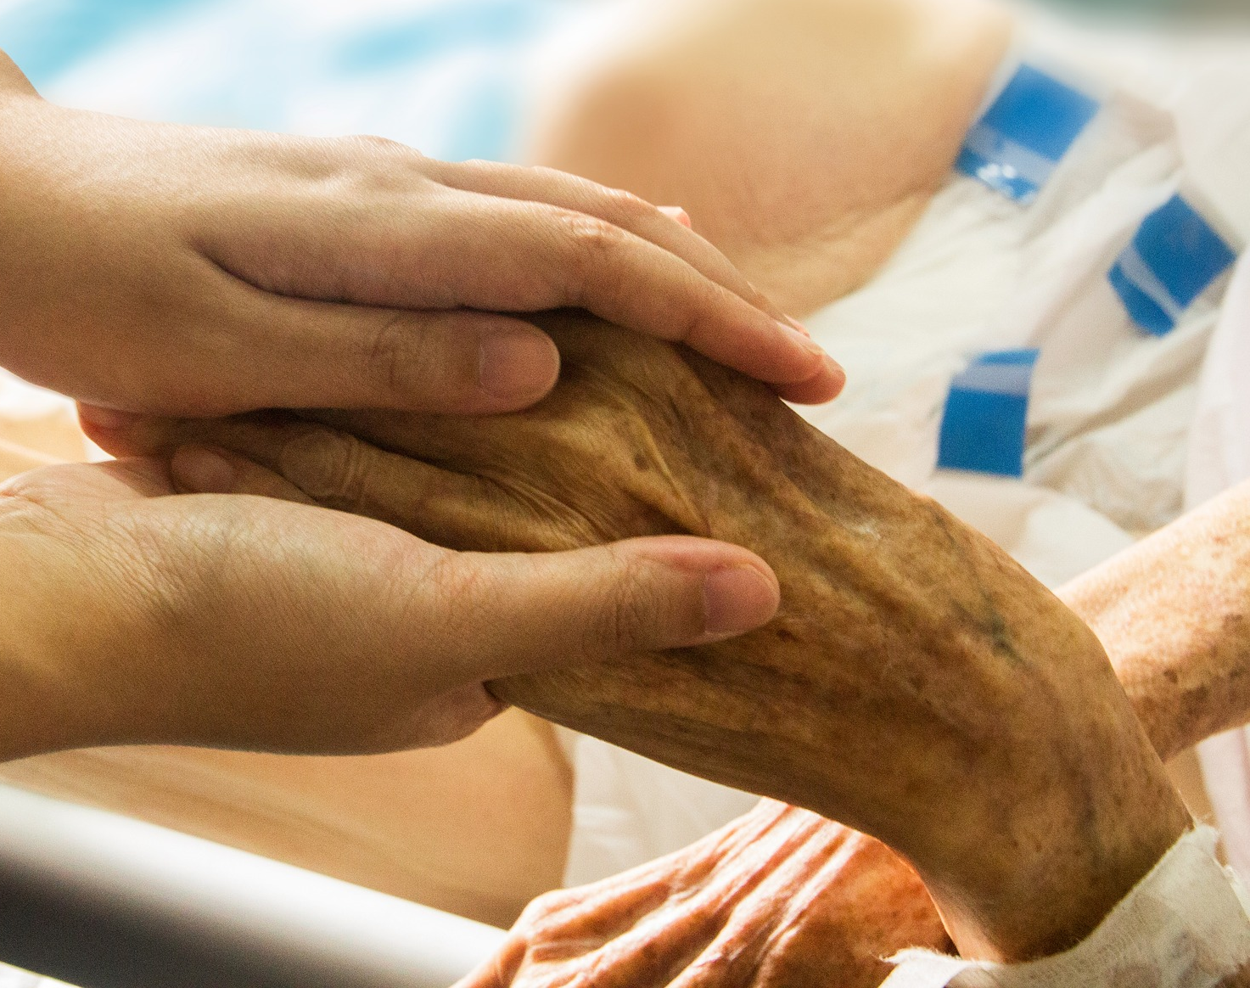
Living Our Lives in a Coma
How aware are we of both ourselves and the world that we live in? Do we really stop long enough to analyze what’s happening within us and around us? Is there a sense where we live our lives in a coma? Are we just not present?

Slide 78
Living Our Lives in a Coma
The world is too difficult. The challenges are too overwhelming. Hope is a distant idea rather than an intimate reality. Our lives are too busy or they’re not, so we fill them with meaningless tasks to create busyness. However it happens, how often are we in a coma? And because we are, we don’t pray as astutely informed people lifting up our concerns with precision, relevance, and focus?

Slide 79
Living Our Lives in a Coma
Our dreams?
Our friendships?
Our sense of calling and purpose?
Our ethics?
Our morals?

Slide 80
Living Our Lives in a Coma
Our values?
Our concern for our fellowman?
Our passion to make a difference?
Our concern for ourselves?
Our jobs?

Slide 81
Living Our Lives in a Coma
Our relationship with our kids?
Our finances?
Our responsibility to those who live around us?
Our passion for life?
Our passion for anything?

Slide 82
Living Our Lives in a Coma
Where are the places where we’re in a coma?
Have we been in a coma for so long that we didn’t even realize that we were in a coma?
Where are the places where we need to wake-up, and wake-up now?
Where are the places where we need to shake ourselves awake?

Slide 83
Living Our Lives in a Coma
Because these are the places where prayer is probably needed the most.
These are the places where prayer needs to begin.

Slide 84
Living Our Lives in a Coma
Application:
Take a moment and think through the areas of your life where you are in a coma.
Prayer for awakenings in these areas.

Slide 85
Living Our Lives in a Coma
Application:
Choose three people to pray for:
A Church Staff Member
A Family Member
Someone You Don’t Know

Slide 86
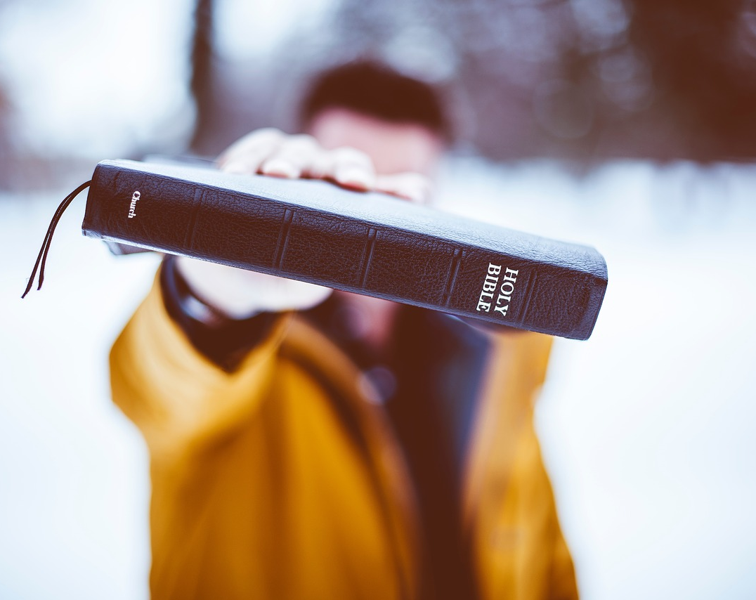
Examples of Prayer in the New Testament
“Theology for Disciples”
Gilbert W. Stafford
Warner Press

Slide 87
Examples of Prayer in the New Testament
Prayer as An Overflowing Fountain
Prayer is an overflowing fountain of praise, adoration, and thanksgiving to God. This kind of prayer erupts without hesitation from the soul. One does not have to make oneself do it, for it comes as naturally as breathing.

Slide 88
Examples of Prayer in the New Testament
Prayer As A Disciplined Community
Prayer is a disciplined communion with God. We see this mainly in the life of Jesus who was able to speak words of healing to the sick and distressed, then bringing to them strength and wholeness. We can also be prayer channels.

Slide 89
Examples of Prayer in the New Testament
Prayer As The Flow of Divine Energy
Prayer is the flow of divine energy to the needs of others. We see this mainly in the life of Jesus who was able to speak words of healing to the sick and distressed, then bringing to them strength and wholeness.

Slide 90
Examples of Prayer in the New Testament
Prayer As The Struggle of the Soul
Prayer is the struggle of the soul in relation to God. In fact, sometimes the struggle is so great that we cannot sort it out well enough even to put the struggle into words. Prayer at those times is simply the wordless anguish of the soul in the presence of God.

Slide 91
Examples of Prayer in the New Testament
Prayer As Mind Seeking God’s Mind
Prayer is the human mind seeking the mind of God. Even though God will give heavenly wisdom to us "generously and ungrudgingly," in order to have it, we must "ask in faith."

Slide 92
Examples of Prayer in the New Testament
Prayer As Intercession
Prayer is intercession to God on behalf of others. In a general sense, to intercede is to put ourselves in the place of others and to plead their case before one who can help them. In intercessory prayer, therefore, appeal is made to God who can make a difference for the good.

Slide 93
Examples of Prayer in the New Testament
Prayer As Petition to God
Prayer is petition to God for our own needs. Petitionary prayer which is truly Christian asks God for that which we are convinced is in accordance with the divine will. It is generous in spirit in that personal needs are prayed about in conjunction with concern for the well-being of others.

Slide 94
Examples of Prayer in the New Testament
Prayer As Watchful Communion With the Lord
Prayer is watchful communion with the Lord, which communion keeps us from yielding to temptation. To watch and pray is work; we need to do more than simply have noble spiritual intentions about not yielding to temptation. To be sure, Peter, on the night of Jesus' arrest, expressed noble intentions about not deserting him, but the problem was that neither he nor the others were watching and praying. They were too weary to be spiritually vigilant.

Slide 95
Observations Regarding Jesus and Prayer

Slide 96
Observations Regarding Jesus and Prayer
Jesus prayed for others.
In Matthew 19:13-14, He placed His hands on the little children and prayed for them. He also prayed in John 17:9, “I pray for them.” His example of prayer underscores the need for intercessory prayer.

Slide 97
Observations Regarding Jesus and Prayer
Jesus prayed with others.
“Jesus took Peter, John and James with Him and went up onto a mountain to pray” (Luke 9:28). Jesus knew the value of praying with others.

Slide 98
Observations Regarding Jesus and Prayer
Jesus prayed alone.
“But Jesus often withdrew to lonely places and prayed” (Luke 5:16). As much as Jesus understood the value of praying with and for others, He also understood the need to pray alone.

Slide 99
Observations Regarding Jesus and Prayer
Jesus prayed in nature.
What better place to commune with our Creator than among the wonders of nature? Luke 6:12 says, “One of those days Jesus went out to a mountainside to pray.” He could have gone to a synagogue to pray. But there were times when Jesus decided to pray in nature. God’s world is full of wonders to draw us closer to Him.

Slide 100
Observations Regarding Jesus and Prayer
Jesus prayed short and long prayers.
The Lord’s Prayer, full of wisdom, is short and can be easily memorized. But Jesus also dedicated long periods of time to prayer. “Jesus spent the night praying to God” (Luke 6:12).

Slide 101
Observations Regarding Jesus and Prayer
Jesus taught persistence in prayer.
“Then Jesus told His disciples a parable to show them that they should always pray and not give up” (Luke 18:1). The parable Jesus shared is not meant to depict a pestering disciple who finally bugs God enough that He chooses to respond, but about persistence in prayer and waiting on God and His timing.

Slide 102
Observations Regarding Jesus and Prayer
Jesus knew that not all His prayers would be answered as expected.
This is a difficult prayer lesson to learn, but the fact of the matter is that not all our prayers are answered in ways we expect. Even Jesus knew this hard lesson as He cried out to God the Father from Gethsemane, “Yet not as I will, but as You will” (Matthew 26:36-44).

Slide 103
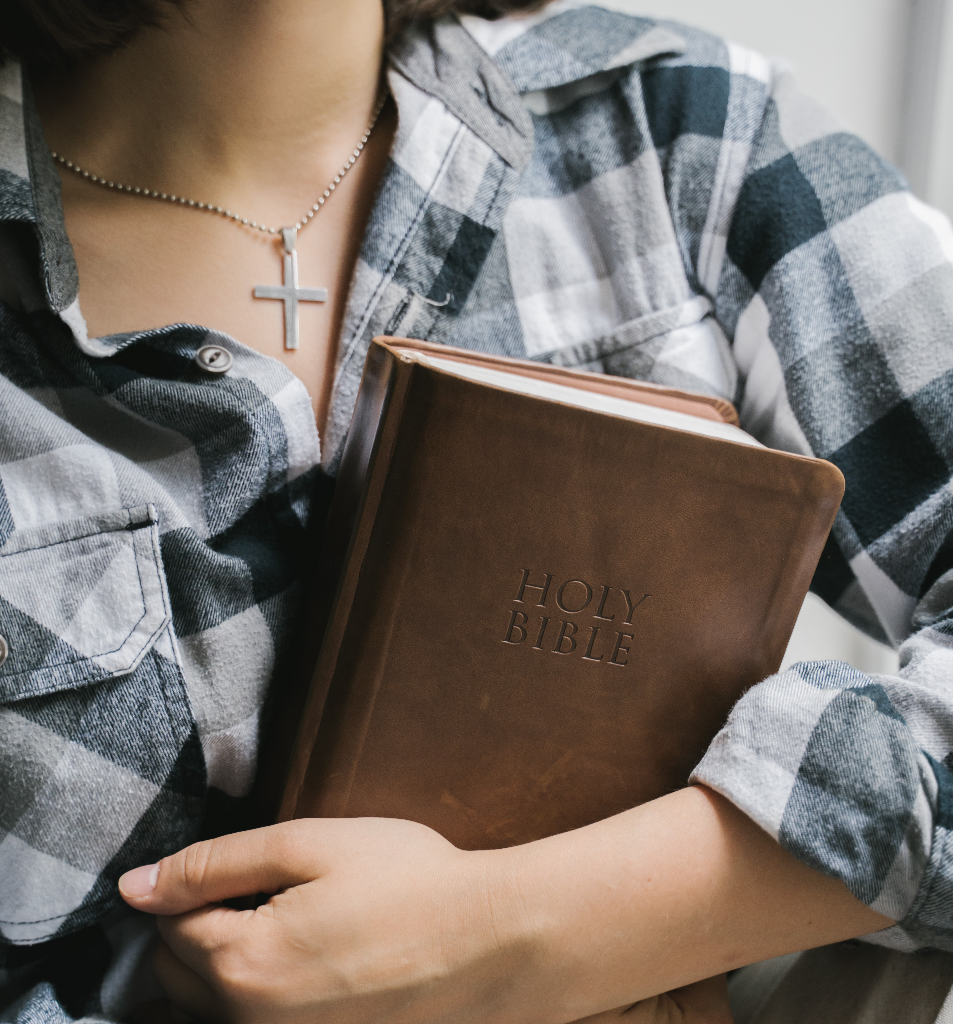
Prayer – The Importance of Our Attitude
No One Is So Lost That They Can’t be Found
It’s Not That God Doesn’t Show Up, It’s That We Don’t Show Up
No Situation is Impossible
Of Course, the Odds Are Against Us, But They’re Not Against God
Surrender, Surrender, Surrender

Slide 104
Prayer – The Importance of Our Attitude
It Can Be Different…It Can!
The Choices of Others Do Not Need to Be Our Lot in Life
Prayer is Part of Cultivating Who God Designed Us To Be, and Eliminating What He Did Not
Prayer Never Stops at Just Changing Us
Finally, Are We Seeking Out the Places Where the Hurting Are Praying?

Slide 105
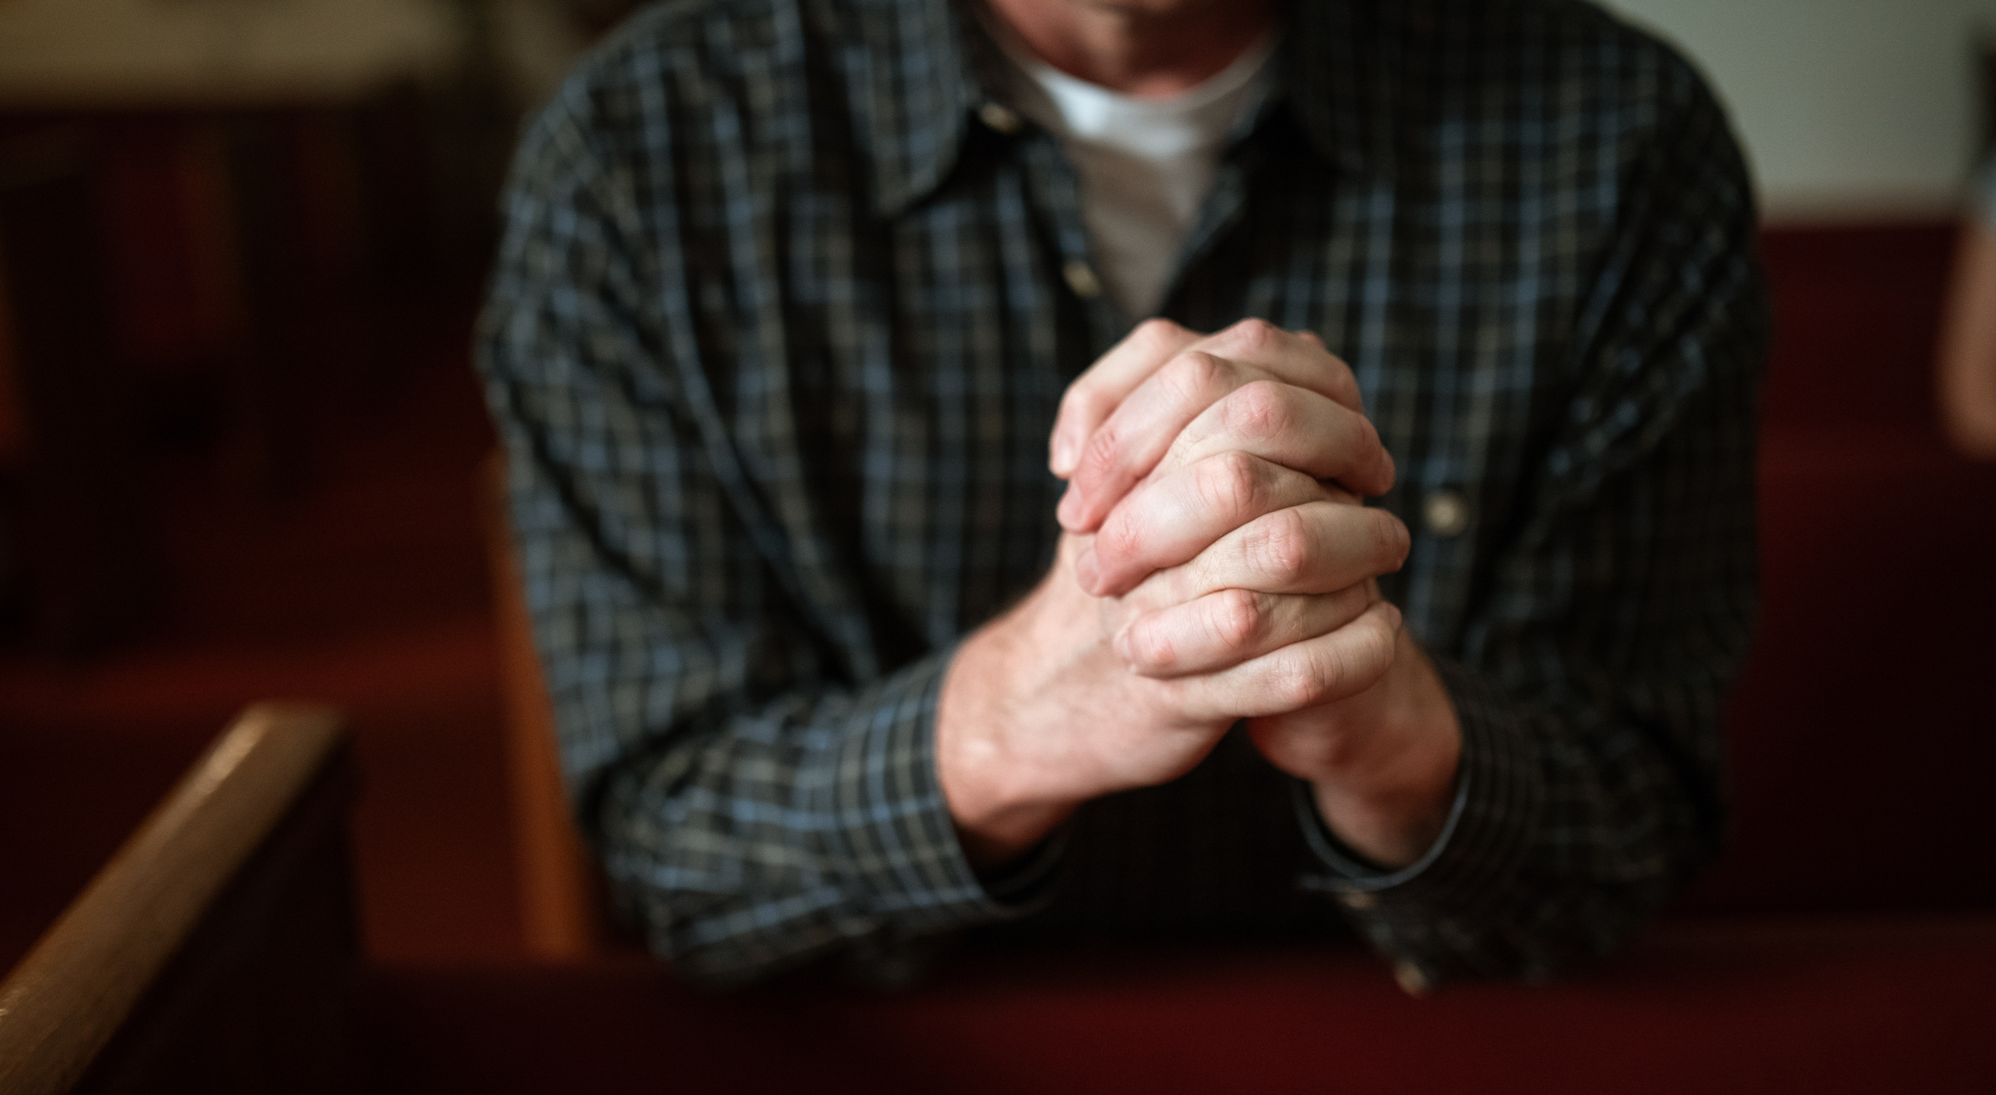
What Prayer is Not

Slide 106
What Prayer is Not
The Cosmic Vending Machine
Viewing God as a resource that dispenses whatever we ask for. Faith is the currency that maximizes the vending machine dispensing the product that we are asking for. If the product is not dispensed, we assume that the machine is broken, rather than understanding that the dispensing of the product may not be in our best interest. In this model we have taken prayer as this rote action rather than action that arises out of relationship.

Slide 107
What Prayer is Not
The Laundry List
Our needs, agendas, desires, wishes, hopes, dreams, etc. are put into list form. The format for prayer becomes a repeated recitation of this list until items are checked off or other items are added. Prayer becomes a form of ‘one-stop-shopping’ that is designed to acquire what we want.

Slide 108
What Prayer is Not
A Spiritual Panic Attack
Prayer is related to a current crisis. We have come to prayer in response to an emergency or some life event that is catastrophic at some level. We are in crisis. Our lives are in jeopardy or there has been a painful turn of events that has collapsed our world in some form and sent us reeling. Once the event has passed, the urgency for prayer is reduced.

Slide 109
What Prayer is Not
Manipulation
We come to prayer with the intent of having our desires fulfilled rather than exploring through prayer what our desires should be. These prayers are agenda driven and are done to achieve our particular goals rather than join God In His goals.

Slide 110
What Prayer is Not
Bargaining
This type of prayer is where the individual attempts to strike a bargain with God. There are promises of some kind of improved behavior, or the abandonment of old behaviors, or assurances of a greater devotion to prayer, or a fuller commitment to family, or the giving of money or some other resource. The intent is to wrangle and deliver a sales pitch that will draw God into some sort of agreement.

Slide 111
What Prayer is Not
Biblical Coercion
This type of prayer takes the authority and principles outlined in scripture and twists them to suit the agenda of the individual. This is an effort to press God to service on our behalf based on the promises He has given us in scripture. In essence, we are backing God into a corner using His own words against Him when we have manipulated and skewed those words beyond their real purpose and intent.

Slide 112
What Prayer is Not
Unprayed Prayers
Prayers that we have not prayed. Those things that we have withheld from God because we don’t believe that He will answer, or we fear that the task might be too big for Him, or we feel that the issue is not all that important, or we are not that important. These are things that we have withheld for any number of reasons that can diminish the whole of our prayer life.

Slide 113
What Prayer is Not
A Means to An End
As noted in the examples above, prayer is not a means to an end. It is an intimate, dynamic and perpetual relational encounter with God within which that relationship grows. It is a time with the Creator of the universe and the Savior of your soul design to enhance intimacy and connection to Him. It is walking with God in deep communion and growing fellowship. It is a means to intentionally build that relationship and grow both in union with God and as the individual that He created you to be.

Slide 114
What Prayer is Not
Testing of God
Many times, our prayers are a test of God. Is He real? If He is, does He love me enough to follow-through? Does He care enough to give me what I ‘think’ I need? Will He take the time to listen to ‘little-old-me?’ Am I important enough for God to turn aside from all of His obligations and sit with me? Is this all truly real and can I stake my life on it?

Slide 115
Obstacles to Prayer

Slide 116
Obstacles to Prayer
Many obstacles are things that we have not given sufficient attention to or presume as somehow normal or appropriate. They represent a less than attentive understanding as to how God has called us to live out our lives.

Slide 117
Obstacles to Prayer
Sin
An intentional living outside of the will of God that places us at odds with who God created us to be. Sin is described as “anything that separates us from God.” If we are engaging in such behaviors, we come to prayer separated from the God to Whom we are praying.

Slide 118
Obstacles to Prayer
Self-Centered Agendas
We tend to live out our lives based on our agendas and our perception of what is in our best interest. Therefore, we do not come to prayer seeking God’s direction, will, insights and perspective. Rather, we come with a prepared agenda where we wrangle with God in order to achieve these agendas or obtain the resources to achieve them.

Slide 119
Obstacles to Prayer
Distractions
Prayer becomes the thing that we squeeze into the many demands in our lives. It is something that sits somewhere on the rather extensive checklist that outlines our obligations and duties. We intend to give it space and time, but it often falls prey to the many other demands that press prayer off of our calendar.

Slide 120
Obstacles to Prayer
Our Perspective of Prayer
Often, we have developed an understanding of prayer as something that has value, but something that can be missed without extensive consequence to our lives. We don’t see it as interacting with the God of the universe as an integral part of growing in relationship with Him and profoundly living out our lives. It is more a prescribed duty that (if fulfilled) is optimal. But should time not permit, there is little lost.

Slide 121
Obstacles to Prayer
Shiny Object and Squirrels
There are many things that vie for our attention, and we give many of those things our attention. Most of those things are not imperative to life and living, although we grant them that status. It is often assumed that if something demands our attention it is because ignoring it will have dire consequences, when in fact it is likely that any consequences will be marginal to non-existent.

Slide 122
Obstacles to Prayer
Lack of Faith
We are lacking in faith. Therefore, we assume that if we are to progress in life and achieve whatever we need to achieve, we will be the one’s doing most of the work. Prayer becomes supplementary as we assume that if these things are to come to pass in our lives, it is our efforts, our wisdom, our strategies and our resources that will bring them to pass. Prayer helps, but it becomes secondary to our efforts.

Slide 123
Obstacles to Prayer
Unmet Expectations
We come to prayer with expectations regarding the outcome of our prayers or what we wish to obtain or feel. If those outcomes are not met in light of the greater outcomes that God has for us, we feel that prayer is ineffectual or irrelevant.

Slide 124
Obstacles to Prayer
A Jaded Heart
God has not answered our prayers in the way that we wanted, or in the time frame that we wanted, or maybe He didn’t answer them at all (which is an answer, but not the one that we hoped for). We have found God disappointing, demanding, a less than generous God, and one that crushes our desires despite how passionately we bring them to Him. Therefore, we either refuse to pray any longer, or we do so in such a limited fashion that there is no room to build that relationship with God (as we don’t trust or assume that we will have to largely fend for ourselves).

Slide 125
Obstacles to Prayer
The Lure of the World
Is our priority really the world around us? And is prayer some supplemental thing that we do out of guilt, or a sense of obligation, or to cover the holes that we might have left in our efforts to tidy up our lives, or to ensure that our efforts are pushed through to our satisfaction? Is prayer that safety net that we keep in place just in case the world fails us, or we fail ourselves? Is prayer that supplemental insurance policy that we hold onto ‘just in case?’

Slide 126
Habits of Prayer Obstacles That Hinder Effective Prayer By John Kincaid Peace in Believing Ministries
The Bible lists sinful attitudes which hinder our prayers, such as trying to pray: When you don’t know God through Christ. John 14:6 When you haven’t repented, and still cherish your sin. Psa.66:18-19; Prov.28:9; Isa.1:15 For show, when you are trying to impress others. Matt.6:5

Slide 127
Habits of Prayer Obstacles That Hinder Effective Prayer By John Kincaid Peace in Believing Ministries
Repetitive, empty words instead of heartfelt requests. Matt.6:7-8 Without ever asking God, neglecting to actually pray. James 4:2 With impure motives, selfish, driven by lust for pleasure. James 4:3

Slide 128
Habits of Prayer Obstacles That Hinder Effective Prayer By John Kincaid Peace in Believing Ministries
With impure motives, selfish, driven by lust for pleasure. James 4:3 While mistreating your spouse or loved ones. 1 Pet.3:7 While ignoring the poor, the needs of the others. Prov.21:13

Slide 129
Habits of Prayer Obstacles That Hinder Effective Prayer By John Kincaid Peace in Believing Ministries
While refusing to forgive; bitterness, holding a grudge. Mark 11:25-26 Without faith, doubting, not trusting that God is able. James 1:6-8; Mark 11:24

Slide 130
Habits of Prayer Keys to Effective Prayer By John Kincaid Peace in Believing Ministries
God is willing, able, and pleased to bless His children. Matt.7:11; Rom.8:32; 2 Cor.9:8 We can overcome obstacles that hinder prayers by following God’s instructions. Pray… By asking, seeking, knocking persistently. Matt.7:7-8

Slide 131
Habits of Prayer Keys to Effective Prayer By John Kincaid Peace in Believing Ministries
With faith. Believe God’s promises to provide for us. Mark 11:24 Privately, in secret where only God can hear you. Matt.6:6 According to God’s will; desire the things that God wants. 1 John 5:14

Slide 132
Habits of Prayer Keys to Effective Prayer By John Kincaid Peace in Believing Ministries
In Jesus’ name. John 14:13-14 In agreement with other believers, to avoid selfish prayers. Matt.18:19-20 While fasting, to depend on God and avoid all distractions. Acts 14:23

Slide 133
Habits of Prayer Keys to Effective Prayer By John Kincaid Peace in Believing Ministries
While walking in obedience, living to please Him. 1 John 3:21-22 While abiding in Christ and His Word, remain in Him. John 15:7 While delighting yourself in the Lord, satisfied in Him only. Psa.37:4

Slide 134
Habits of Prayer Why Continue to Pray? By John Kincaid Peace in Believing Ministries
Persistent prayer doesn’t mean we try to twist God’s arm. It means we are deeply concerned, burdened, and cannot rest until we get God’s answer. Robert Law put it this way: “Prayer is not about getting our will done in heaven; it is getting God’s will done on earth.”

Slide 135
Habits of Prayer Why Continue to Pray? By John Kincaid Peace in Believing Ministries
Pray for God to give you endurance to keep on praying for His will to be done. Daniel (9:3-19) prayed a great prayer of intercession for God’s people. Daniel (9:2-3) realized God planned to keep Israel in captivity for 70 years, then release them.

Slide 136
Habits of Prayer Why Continue to Pray? By John Kincaid Peace in Believing Ministries
Then Daniel did a strange thing: he prayed that God would do what God planned to do. But if God intends to do (or wants us to have) something, why should we bother to pray? Daniel showed us a powerful principle of prayer; all believers should follow his example.

Slide 137
Habits of Prayer Why Continue to Pray? By John Kincaid Peace in Believing Ministries
It’s a waste of time to pray for things that God has forbidden. It’s never right to pray for things that God has already said are wrong. But God commands us to pray for everything else. God knows the future; He knows the plans He has for us. Jer.29:11-13

Slide 138
Habits of Prayer Why Continue to Pray? By John Kincaid Peace in Believing Ministries
1 John 5:14-15 God hears and answers prayers according to His will. Yet God still expects us to pray over His plan, day by day. Why? For what purpose? Prayer is not about trying to persuade God to change His mind. God’s will is perfect.

Slide 139
Habits of Prayer Why Continue to Pray? By John Kincaid Peace in Believing Ministries
Why would we want God to change the perfect plan that He has in mind for us? Instead, we need to conform. Prayer is not about asking God to bend toward my desires. I ask God to reveal His will for me. I ask Him to help me obey, to adjust my life to His will.

Slide 140
Habits of Prayer Why Continue to Pray? By John Kincaid Peace in Believing Ministries
I challenge you: ask God to reveal His will for you. Follow Him; bend your desires toward His. When we pray, and God answers “Yes”, it isn’t God who changes – it’s us.

Slide 141
What Prayer Is - Relationship

Slide 142
What Prayer Is - Relationship
Psychiatrist Gerald May stated:
“After twenty years of listening to the yearnings of people’s hearts, I am convinced that human beings have an inborn desire for God. Whether we are consciously religious or not, this desire is our deepest longing and most precious treasure.”

Slide 143
What Prayer Is - Relationship
R. S. Thomas put it a bit differently:
“Prayers like gravel flung at sky’s window, hoping to attract the loved one’s attention…”

Slide 144
What Prayer Is - Relationship
The Apostle Paul wrote:
“For we do not have a high priest who is unable to sympathize with our weakness, but we have one who has been tempted in every way, just as we are — yet was without sin. Let us then approach the throne of grace with confidence, so that we may receive mercy and find grace to help us in our time of need.” Hebrews 4:15-16 NIV

Slide 145
What Prayer Is - Relationship
The two main words used for prayer in the Bible are translated “petition” or “supplication.” However, they have a far greater depth in their original language.
Hebrew “palal” – bow down/worship; discern (listen); speak to authority.
Greek “proseuchomai” – turn toward/draw near/meet with (which implies a face-to-face encounter); desire/express (emotions are involved).

Slide 146
What Prayer Is - Relationship
Based on these definitions, this kind of prayer incorporates these facets:
Respect and adoration.
A giving of oneself over to God.
To listen (which implies hearing of the voice of God as a priority over focusing on our agendas).
Having confidence that we are heard.

Slide 147
What Prayer Is - Relationship
Based on these definitions, this kind of prayer incorporates these facets:
A partnership that involves an intimate engagement of Creator and created instead of some sort of sterile transaction.
A longing for connection which supersedes any agenda.
An exposure of and expression of the deepest, more vulnerable emotions.
An intimacy that will always result in our good even if the answer to prayer doesn’t appear good.

Slide 148
The Lord’s Prayer
The Master’s Model

Slide 149
The Lord’s Prayer
The Master’s Model
“Our Father"
Our focus in prayer is on ‘our’ Father. Prayer is an intentional intimacy with the most significant Person in our existence both today, tomorrow, and throughout the whole of eternity. Jesus begins by acknowledging the nature, importance, power, and priority of this relationship. His prayer is prefaced by first placing it in the context of intimate relationship.

Slide 150
The Lord’s Prayer
The Master’s Model
“Who art in heaven”
This positions the Person who we are addressing. This describes God’s address and attributes to Him the power of that place. There is a superiority to this relationship that is unparalleled by any other relationship. This is not a horizontal relationship with someone who is burdened with the same limitations that we are burdened with, and who struggles with the same issues that we struggle with in the same way that we do.

Slide 151
The Lord’s Prayer
The Master’s Model
"Hallowed be your name"
We have this opportunity for intimacy with this God, but we need to understand the majesty of this God. He is above all. He is supreme. He alone controls the whole of the universe. We are granted access to the throne that is exalted above every throne. This creates a respect as we approach prayer.

Slide 152
The Lord’s Prayer
The Master’s Model
"Your kingdom come, your will be done"
We are asking for His kingdom to come in all of its spiritual qualities of love, joy, peace, patience, kindness, goodness, gentleness, faithfulness and self-control. We are asking God to impart those qualities in our lives, our families, our businesses, our communities, our nation, and our globe. These attributes embody all of the things that our world needs.

Slide 153
The Lord’s Prayer
The Master’s Model
"Give us this day our daily bread"
We tend to focus on the spiritual in prayer. However, we can trust God for our physical as well as spiritual provisions in our daily prayers. His resources are without limits. He is not working with a limited inventory as “every animal of the forest is mine, and the cattle on a thousand hills.” (Psalm 50:10). God’s provisions are eternal, endless, and always sitting at the ready.

Slide 154
The Lord’s Prayer
The Master’s Model
"Forgive our trespasses as we forgive those who trespass against us."
One of the greatest barriers to effective prayer is a lack of forgiveness. We carry within us transgressions, thoughts, biases, prejudices and many other things that create a steadfast barrier between ourselves and God. Therefore, we must purge ourselves of these lesser things so that this communication with God is not impeded, blocked or altogether destroyed.

Slide 155
The Lord’s Prayer
The Master’s Model
"Lead us not into temptation"
Each of us has a tendency to sin. That’s the fallenness of our nature. Without God’s help, we will self-destruct by eventually giving into the passions of our sinful nature. They will wear us down over time, show up in situations that make us vulnerable to them, reshape themselves in order to present as increasingly appealing, make us question if they are really all that bad, or find whatever vulnerabilities that we might have in order to take full advantage of our weaknesses.

Slide 156
The Lord’s Prayer
The Master’s Model
"Deliver us from evil”
As Paul says, we battle not against flesh and blood, but against the forces of darkness. Without God’s intervention we are all vulnerable to destruction by the devil, demons, fallen people, and a fallen world. We must look to God to keep us aware of indiscrete words, gossip, backbiting, anger, jealousy, discontent, rage, revenge, lust, envy, lying, deceiving, and apathy.

Slide 157
The Lord’s Prayer
The Master’s Model
For You Alone Own the Kingdom and the Power and the Glory Forever.”
All things are from God. For by the Lord all things exist and were created. He is the sole source of every breath, every resource, and every good thing. And because all things stem from Him, God deserves all the praise, honor and glory. We are His people and the sheep of His pasture; an exclusive and total relationship.

Slide 158
Practical Application of Prayer
Praying Beyond Ourselves – Daring to Take on the Impossible

Slide 159
Practical Application of Prayer
Praying Beyond Ourselves – Daring to Take on the Impossible
“You do not have because you do not ask God.”
James 4:2 (NIV)

Slide 160
Practical Application of Prayer
Praying Beyond Ourselves – Daring to Take on the Impossible
To Pray Within My Limitations is Just Talking
To Pray Without Risk is Just Talking
To Pray When the Challenge is Bigger Than Us It to Believe That God Still Slays Giants and That He Uses Us to Do It
To Pray and Leave the Outcome to God is the Surrender Without Which Prayer Becomes Our Agenda

Slide 161
Practical Application of Prayer
Praying Beyond Ourselves – Daring to Take on the Impossible
To Think that We Are Not the Ones to Pray is to Miss What May Never Come Again
To Wish It Were Not Us Is to Believe that God Made a Mistake
To Believe that Prayer Can Raise Others Out of Their Comas is Part of Being Raised Out of Ours
To Pray Realizing That What We Ask for We Can’t Do, Which is Why God is Waiting for Us to Ask Him to Do It

Slide 162
Practical Application of Prayer
Praying Beyond Ourselves – Daring to Take on the Impossible
To Know that We Don’t Need to Know Everything that We’re Praying About for It to Be Effective
That Prayer is Not the Last Resort, But the First Course of Action

Slide 163
A Practical Outline of Prayer By Marilee Pierce Dunker World Vision
Know to Whom You Are Speaking
Prayer is a conversation with God, and every conversation begins by addressing the person to whom you are speaking by name. Jesus begins with “Our Father in heaven.” He focuses on a distinct person — the Heavenly Father with whom he has a personal relationship. We share the same right to call God “Father,” and there are times when we need to talk with our Abba Father, Daddy God. But God is three distinct persons in One: the Father, the Son, and the Holy Spirit.

Slide 164
A Practical Outline of Prayer By Marilee Pierce Dunker World Vision
Thank Him
A heartfelt thank you is always a great conversation starter. Like any parent, God loves to see that we have grateful hearts. But more importantly, as we take the time to praise God for all He has done in the past — the answered prayers, the impossible situations overcome, the healings and grace — our faith to believe for even greater answers to prayer grows stronger and more confident. Praise opens the gates of heaven and should always be part of our alone time with God.

Slide 165
A Practical Outline of Prayer By Marilee Pierce Dunker World Vision
Ask for God’s Will
The Lord’s Prayer is not the only place where Jesus role-modeled a heart of obedience and submission to the will of God over his own desires and needs. In the Garden of Gethsemane, only hours before Jesus’ crucifixion, he would once again pray, “not my will, but yours be done.” In a world where right and wrong are frequently confused and the future is so uncertain, it can be hard to know how to pray or what to ask for when difficult circumstances arise. But the one thing we can know with absolute certainty is that God’s plan for those who love him is good, and the safest place we can be is in the center of his divine will.

Slide 166
A Practical Outline of Prayer By Marilee Pierce Dunker World Vision
Say What You Need
In Jesus’ time, bread was a staple — one of the most basic needs of life — and he did not hesitate to ask God to provide it. But we often hesitate to bother God with the little things we need, thinking he shouldn’t be bothered. And when the big problems come, we try everything we can to solve the problem before we think to pray. The Bible says, “You do not have because you do not ask God.” So never hesitate to ask God for what you need in 2021. Your Father in heaven delights to give you good gifts.

Slide 167
A Practical Outline of Prayer By Marilee Pierce Dunker World Vision
Ask for Forgiveness
James 5:16 reminds us that if we want our prayers to be heard, our hearts need to be right with God and with one another. If you feel your prayers are bouncing off the ceiling, take some time to check your heart.

Slide 168
A Practical Outline of Prayer By Marilee Pierce Dunker World Vision
Pray with a Friend
There is power in agreement when we pray in Jesus’ name. When I have an urgent need to take before the throne of God, I will often call a friend to pray with me. If you don’t already have one, make finding a trusted prayer partner one of your goals in 2021.

Slide 169
A Practical Outline of Prayer By Marilee Pierce Dunker World Vision
Pray the Word
My mother was a spiritual prayer warrior, and much that I know about prayer I learned from her. I loved to listen to her pray because for every need or situation, she would claim a scripture of promise. “The Word of God has power and is our great spiritual weapon,” Mama would say. “Pray the Word, Marilee. Pray the Word.”

Slide 170
A Practical Outline of Prayer By Marilee Pierce Dunker World Vision
Memorize Scripture
The most important key to a vibrant prayer life is to understand our spiritual authority in Christ as explained in the Scriptures. The only way to do that is to become intimately familiar with the Bible. Even a few minutes a day in the Word of God will add strength and authority to your prayers in 2021.

Slide 171
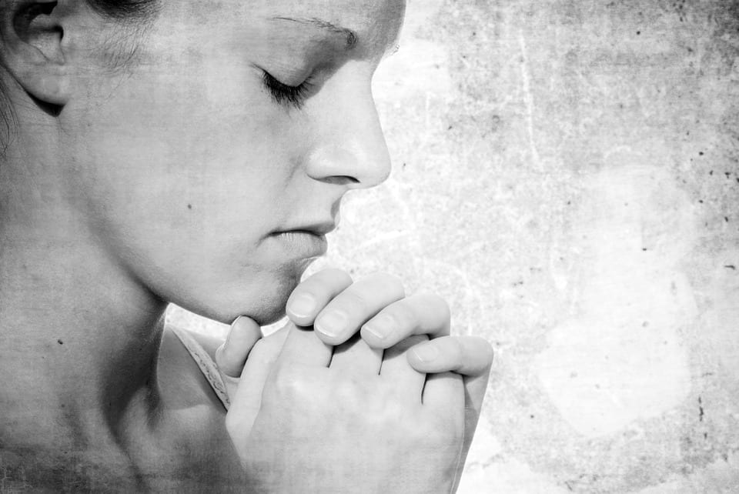
Additional Suggestions My Personal Strategies Craig D. Lounsbrough
Have a Designated Place to Pray
Find that place in your house or apartment that becomes the place where you meet God. When you do this, this place takes on an aura or a sense that this is where you encounter God. This feeling that this is the place where you meet God can enhance your prayer time.

Slide 172
Additional Suggestions My Personal Strategies Craig D. Lounsbrough
Have a Designated Time to Pray
While we are to pray throughout the day, find one time that is exclusively your time with God. While mornings tend to be busy for most people, try to find a time at the beginning of your day as you are more rested during that time, and your time with God sets the tone for the day.

Slide 173
Additional Suggestions My Personal Strategies Craig D. Lounsbrough
Track Scriptures In Your Bible As God Gives Them To You
Have a Bible where you can track scriptures that God brings to you, or ones that you discover throughout the day, or ones that a friend gives you. Mark them in your Bible, place the date by them, and mark the page with a sticky note.

Slide 174
Additional Suggestions My Personal Strategies Craig D. Lounsbrough
Have Some Accompanying Material
Have something that you read daily or possibly weekly as part of your prayer time. This could be a pamphlet, a regular devotional, a newsletter, an article that you found of value, a chapter in a book, etc. Have these to refer to as part of your time with God.

Slide 175
Additional Suggestions My Personal Strategies Craig D. Lounsbrough
Your State of Mind
Realize that some days you might come to prayer very focused. Other days, you might be more scattered. Some days you might have a strong sense of what you want to pray about, and at other times you may not. Simply bring who you are at that moment. It’s not so much what you showed up with, as it is that you showed up.

Slide 176
Additional Suggestions My Personal Strategies Craig D. Lounsbrough
To End Your Day
Have some Bible reading at the end of your day to round out your day. This could be a devotional, or part of reading through a particular book of the Bible, a “One Year Bible,” or referencing a scripture that you read during your time in the morning.

Slide 177
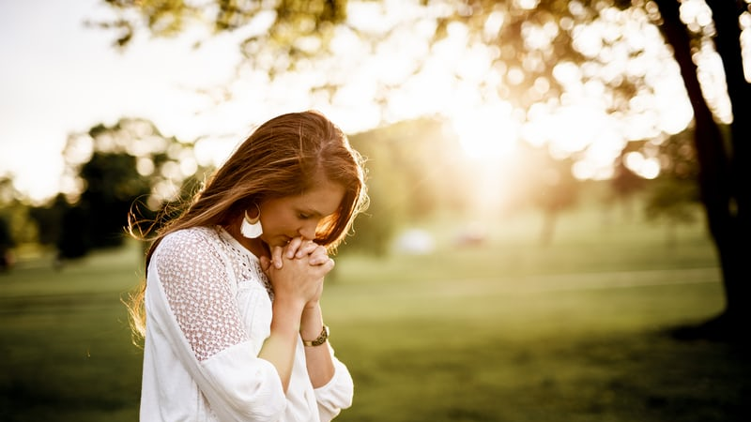
Concluding Thoughts
"To be a Christian without prayer is no more possible than to be alive without breathing.” - Martin Luther
“Prayers outlive the lives of those who uttered them; outlive a generation, outlive an age, outlive a world.” - E.M Bounds
“Prayer is the soul’s traffic with Heaven; God comes down to us by His Spirit, and we go up to Him by prayer.” - Thomas Watson
“History is silent about revivals that did not begin with prayer.” - Edwin Orr
“The great people of the earth today are the people who pray, (not) those who talk about prayer.” - S.D. Gordon
“Rejoice always, pray continually, give thanks in all circumstances; for this is God’s will for you in Christ Jesus.” - 1 Thessalonians 5:16-18 (NIV) - The Apostle Paul

Slide 178
Concluding Thoughts
“My prayer is not for them alone. I pray also for those who will believe in me through their message, that all of them may be one, Father, just as you are in me and I am in you. May they also be in us so that the world may believe that you have sent me. I have given them the glory that you gave me, that they may be one as we are one—I in them and you in me—so that they may be brought to complete unity. Then the world will know that you sent me and have loved them even as you have loved me.”
- John 17:20-23 (NIV) – Jesus Christ

Slide 179
Concluding Thoughts
“It is my prayer that ‘prayer’ becomes a central feature in your life. Life can difficult. It can come at us in ways entirely unexpected, and it can do so with absolutely no remorse. We can watch spouses walk away, standby as careers vanish in an instant, helplessly watch our children destroy their lives, wrestle with unrelenting addictions, fall deep into the throes of depression, be relentlessly haunted by trauma, witness the betrayal of friends, hate who we are, hate who we are becoming, and so much more. Life can be hard. Very hard. Extremely hard.
But prayer is the empowerment in the midst of our impoverishment. It is the hope when all other supposed ‘hopes’ fail us (as they will). It is the living lifeline to our God. It is the most under-used asset in our arsenal. It is power beyond our understanding and deliverance beyond our abilities. If we've been foolish enough to underestimate the power of prayer, then we've probably been naive enough to overestimate the power of everything else. Therefore, from this point forward may we take it upon ourselves to pray as we never have before, so that we might change our world as never before.”
- Craig D. Lounsbrough, M.Div., LPC
Email address: craiglpc4@gmail.com
Website: www.craiglpc.com

Slide 180
Contact Information
Craig D. Lounsbrough, M.Div., LPC
Licensed Professional Counselor
Certified Professional Life Coach
19284 Cottonwood Drive, Suite 202
Parker, Colorado 80138
303-593-0575
Email address: craiglpc4@gmail.com
Website: www.craiglpc.com

